Slide 1
Resumable uploads on the web:
past, present and future
Marius Kleidl
FOSDEM, Browser and web platform track
31 January 2026

Slide 2

Hello, I’m Marius Kleidl 👋
Senior Backend Engineer @ GetStream.io
🌐 mariuskleidl.net
📧 hello@mariuskleidl.net
🟦 linkedin.com/in/marius-kleidl

Slide 3
<form method="post" enctype="multipart/form-data">
<input type="file" />
<button>Upload</button>
</form>
<form method="post" enctype="multipart/form-data">
<input type="file" />
<button>Upload</button>
</form>
👈
📜 First standardized
in RFC 1867 from 1995

Slide 4
❗
⬆️
📶
Unreliable networks
📦
Large files
👉 Any interruption causes the upload to fail 😥

Slide 5
Resumable uploads to the rescue!
💭
🎞️
50%
📱 🗄️
❌
❔
🗨️
💬
📱 🗄️
50%
🎞️
📱 🗄️
✅
👉 No more re-uploads 🙌

Slide 6
User experience benefits
1️⃣ Recover uploads from transient failures:
connection drop, server crash, device shuts down etc.
2️⃣ Pause and resume uploads based on user intent
3️⃣ Prioritize real-time traffic over low-priority uploads
e.g. for video calls
4️⃣ Automatically pause uploads based on network conditions:
e.g. when switching from WiFi to metered network

Slide 7
Early days of resumable uploads…
⚖️
Implement your own proprietary solution
Use a platform-/stack-
specific OSS project

Slide 8

In 2013 we started tus.io to create…
📜
Open, HTTP-based protocol for
resumable uploads
🛠️
Open source libraries that are easy to integrate everywhere

Slide 9
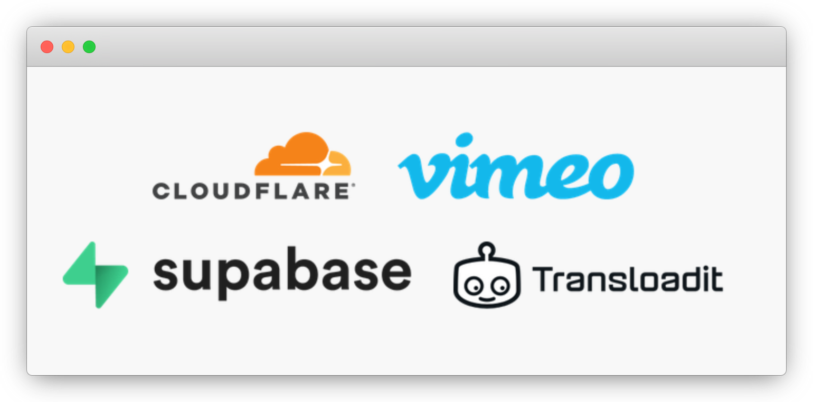
📖 Tus is an open protocol
👉 Public APIs can use tus for resumable uploads
Notes:
tus is used by Polish firefigthers

Slide 10
Resumable uploads under the hood
Upload resource
👇
🎞️
📱 🗄️
POST /files
Length: 20,000
❌
Location: /files/123
❔
🗨️
💬
📱 🗄️
50%
HEAD /files/123
Offset: 10,000
🎞️
📱 🗄️
PATCH /files/123
Offset: 10,000
✅

Slide 11







Tus clients
Tus servers
JavaScript*
Java
Android
iOS
& many more…
Node.js
Go
Java
.NET
& many more…
⚠️ Every application needs their own client
⚠️ Restrictions from the environment limit capabilities

Slide 12
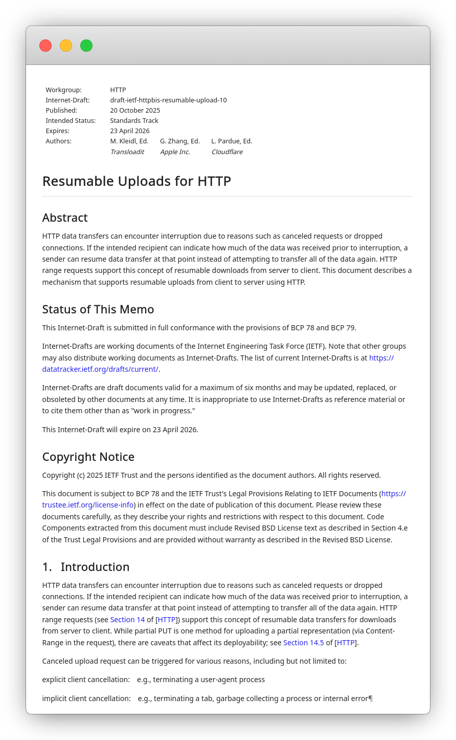
Making it official
In 2022 the HTTP WG at the IETF adopted a resumable uploads extension for HTTP
  Bring resumable uploads into HTTP implementations: clients, servers, proxies etc.
  Get more stakeholders involved
Currently in Working Group Last Call
Already implemented in Swift’s URLSession
Transparent fallback to “classic” uploads

Slide 13
Let’s bring it into browsers!
No more JS library needed
Progressively enhance uploads to be resumable
Browser could …
  pause uploads to prioritize real-time traffic
  resume upload when device awakes
await fetch(url, {
method: "POST"
body: file,
resumable: true,
})
github.com/whatwg/fetch/issues/1626

Slide 14
Key takeways
1️⃣ Resumable uploads improve user experience
2️⃣ OSS projects make integration easy today: tus.io
3️⃣ Support is coming to a device next to you!
4️⃣ You can start your own protocol today and …
5️⃣ … let it mature at the IETF, W3C, WHATWG etc.
🌐 mariuskleidl.net
📧 hello@mariuskleidl.net
🟦 linkedin.com/in/marius-kleidl

